Slide 1
UNC Greensboro’s Veteran’s Access Program for Nursing
Susan Letvak PhD, RN, FAAN
UNC Greensboro School of Nursing
saletvak@uncg.edu

Slide 2
NC Veteran Population
3rd highest active duty military population in the US
776,000 veterans live here
6th in post 9/11 veterans
8.2% of post 9/11 veterans are without jobs
Veterans 18-34 have a 20% poverty rate

Slide 3
Registered Nurse Workforce
Nationally over 55% of RNs have a Bachelors degree- in NC only 34% do.
We need Bachelors prepared nurses in NC to provide the highest quality of care.
The need for RNs will continue to grow and shortages are already occurring throughout the state.

Slide 4
Veterans= Great Nurses!

Slide 5
The UNCG School of Nursing Veterans Access Program (VAP)

Slide 6
HRSA Grant Funded
Nurse Education, Practice, Quality and Retention Veterans’ Bachelor of Science in Nursing Program.
UNCG School of Nursing is in the second cohort to be funded (over $1 million received). Finishing our second year.
The grant “forced the hand” of faculty to accept the Joint Service Transcript (JST) as academic credit.

Slide 7
UNCG Veteran Access Program
Enlarged our nursing program by up to 24/year
Transition to civilian nursing course
Customized clinical opportunities
Counseling support
Specialized tutoring
Reimbursement for fees
Start up kit
A study room/computers
Financial safety net
20 enrolled now- 24 more coming this fall!

Slide 8
Attracted Donor Support

Slide 9
Awarding Academic Credit
We are utilizing the Joint Service Transcript to provide direct college credit.
Students can complete our five semester program in as little as THREE SEMESTERS- saving GI benefits for graduate school and getting vets into the workforce.
Can also competency test if unsure of knowledge/skill base

Slide 10
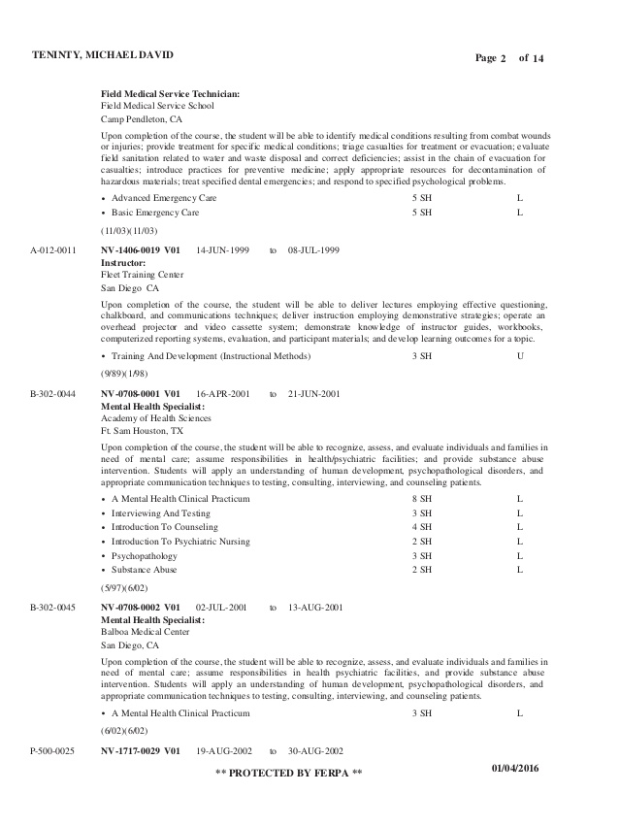
Sample JST

Slide 11
Next Steps
At UNC Greensboro: working with the Registar and other departments to award college credit for veterans in ALL programs- not just nursing
For the UNC System: spreading the message as part of the GA MCAC - assisting other programs to accept military course work/experience for college credit.

Slide 13
QUESTIONS?

