Slide 1
North Carolina’s
NCWorks Career Centers

Slide 2
NCWorks Career Centers
WIOA
Commission
Workforce Development Boards
NCWorks Career Centers
Notes:
Commission under WIOA:
Serves as North Carolina’s WIOA State Board
Oversees North Carolina’s workforce development system and advises leadership on how to strengthen the state’s workforce
Oversees the NCWorks Career Centers

Slide 3
US Department of Labor Funds
Oversight
Financial Management
Staff Development
Performance Management
TAA
Vets
WIOA Title III
WIOA Title I
Staff
Facilities
NCWorks Online
Oversight
Division of Workforce Solutions
Local Area Workforce Boards
NCWorks Career Centers
Notes:
Like I mentioned before the NCWorks Commission oversees the NCWorks Career Centers while the WDBs have the responsibility to operate them.

Slide 4
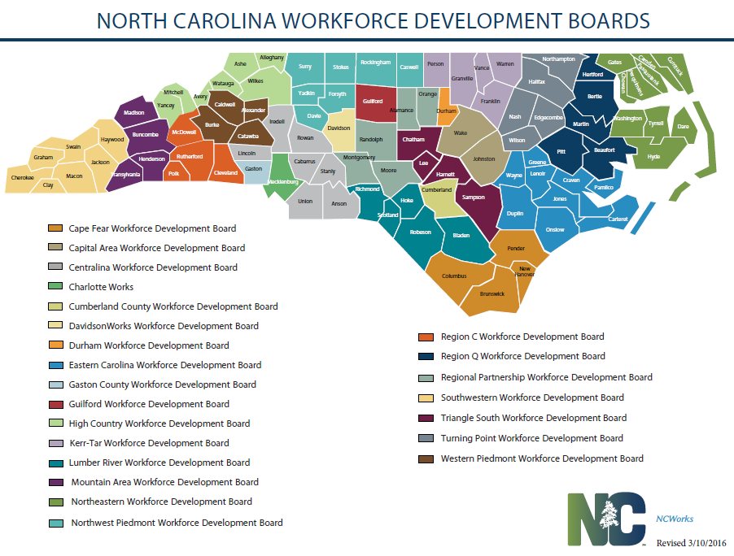
Local Workforce Development Boards
Notes:
North Carolina has 23 local workforce development boards that are working to ensure all communities have the capacity to provide high quality services to individuals and businesses across the state.
Local boards have representation from the Division of Workforce Solutions, community colleges, and local vocational rehabilitation programs to ensure coordination and capacity building at the local and regional level.
23 local workforce areas. And like this commission, the 23 local workforce development boards are made up and led by a private sector majority. By law, the boards role is to:
Local planning
Regional labor market analysis
Convener of workforce stakeholders
Engages regional employers
Develops and implements career pathways
Operates career centers
In addition, each board is required at minimum to have one certified NCWorks Career Center.
And for those of you who’ve put some homework time in, the NCWorks Commission is responsible for creating the criteria for the certification process.

Slide 5
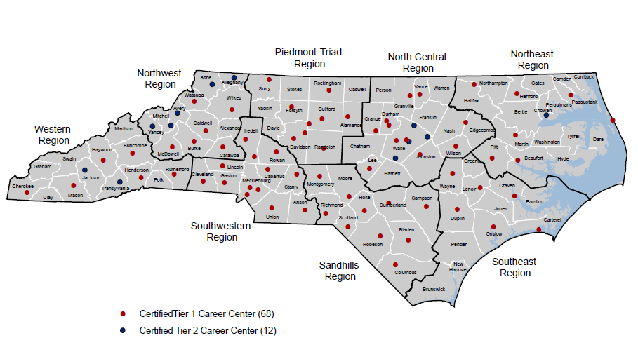
NCWorks Career Center Locations
Notes:
North Carolina’s focus for the NCWorks Career Center is on achieving a culture of quality customer service. The career center system is established to provide improved performance, coordinated access to services, and service delivery accountability. These centers serve as the front-line touch points for the state’s job seekers.
Approximately 80 career centers, located throughout the state.
Each certified career center is required to have a formal partnership with its local community colleges as well as of the 115 local education agencies
Local boards have representation from the Division of Workforce Solutions, community colleges, and local vocational rehabilitation programs to ensure coordination and capacity building at the local and regional level. NCWorks Career Centers are operated by North Carolina’s 23 local workforce development boards and are overseen by the NCWorks Commission.

Slide 6
NCWorks Career Centers
What is the purpose of an NCWorks Career Center?
To enable individuals to succeed in the workplace by providing skills development, training, or employment services
To help businesses obtain a skilled workforce by providing employment services, training programs, or work-based learning opportunities
Notes:
Commission mission:
To ensure NC has an innovative, relevant, defective, and efficient workforce development system that develops adaptable, work-ready, skilled talent to meet the current and future needs of workers and businesses to achieve and sustain economic prosperity.
Examples of services to individuals
Job coaching
Job search, resume and interview preparation assistance
Assessments such as skill, interest, etc.
Skill development
Education and training
Work-based learning
Assistive technology
Supportive services such as assistance with childcare, transportation, food, clothing, etc.
Examples of services to businesses
Recruiting events such as job fairs
Assessing candidates
Screening and referring candidates to local employers
Work-based learning
Customized training
Assistive technology and other support for companies that hire people with disabilities and barriers to employment
Labor market information

Slide 7
Integrated Services Delivery
Talent Development Team
Welcome
Explore career options
Assess needs/barriers
Identify services
Product Box
Employment!
Register
Orientation
Assessment
Talent Employment Team
Services available to help customers with training or reemployment needs
Explore career options
Job Search
Job referrals
Assess employment opportunities
Notes:
The NCWorks Commission required that in order to become a certified center, there had to be integrated services delivery. The benefit to integration is that we serve people regardless of programs. You can come in seeking any of those services I referenced on the 2nd page and be helped by every member of the team. It’s a real focus on customers first. It’s how we’ve dramatically evolved the UI offices into Career Centers.
By definition: Integrated services delivery focuses on customer service and is organized around services to customers, not discrete programs offered in silos.
Centers implementing this system deploy integrated staffing and use integrated technology to generate an integrated customer pool and customer flow.
Integrated Staffing
Integrated Customer Pool
Integrated Portal – NCWorks Online
Integrated Customer Flow
Staff on functional teams working at the center
Who provides services?
“Career Advisors” – help job seekers find jobs or get access to training
“Business Consultants” – help employers find, train, and retain qualified employees
“Career Advisors – veterans” – work directly with veterans to help them find employment
“Center Managers” – lead our teams in pursuit of success
A central part of the Commission’s criteria is the implementations of what we’re calling ISD or integrated services delivery.
In North Carolina, it is a system in which WIOA Title I Adult and Dislocated Worker programs and the Wagner-Peyser Employment Services program are the operational backbone of NCWorks Career Centers.
Integrated Staffing - refers to center staff organized by function, not by program or employer (funding source), with the purpose of serving customers efficiently and effectively.
Integrated Customer Pool - all customers (when eligibility permits) are enrolled in both the WIOA Title I Adult program and Wagner-Peyser program; and all Trade Adjustment Act customers are enrolled in the WIOA Title I Dislocated Worker program.
Integrated Portal - a single, web-based system (NCWorks Online) that provides job matching services to job seekers and employers, as well as program and client management/participant tracking used by staff.
Integrated Customer Flow - responds to customer need, not just to program requirements. Integrated customer flow refers to four major functions found at a career center that comprise customer welcome, skill development, employment services, and employer services.

Slide 8
The Benefits of Integrated Services Delivery
Seamless service delivery
Efficient use of staff resources
Satisfied customers

Slide 9
Questions?

